Slide 2
A function can also be referred as a method or a sub-routine or a procedure, etc
A function is a group of statements that together perform a task.
Every C program has at least one function, which is main(), and programs can define additional functions since you will be allowed to divide up your code into separate functions

Slide 3
Elements of a function
Function Declaration
Function definition
Function call

Slide 4
Function Declaration
A function declaration tells the compiler about a function's name, return type, and parameters.
The general form of a function declaration in C programming language is as follows
return_type function_name( parameter list );
Ex. void println(void);

Slide 5
Function definition
A function definition provides the actual body of the function.
The general form of a function definition in C programming language is as follows.
return_type function_name( parameter list )
{
body of the function
}

Slide 6
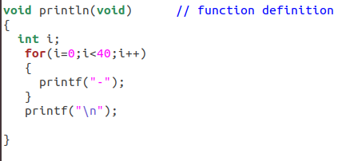
Ex. of function definition

Slide 7
Function call
To invoke a function at a required place in the program.
A function can be called by simply using the function name followed by a list of actual parameters, if any, enclosded in parentheses.
ex. println();

Slide 8
Call by value:
This method copies the actual value of an argument into the formal parameter of the function. In this case, changes made to the parameter inside the function have no effect on the argument.
Call by reference
This method copies the address of an argument into the formal parameter. Inside the function, the address is used to access the actual argument used in the call. This means that changes made to the parameter affect the argument.

Slide 9
Category of Functions
Functions with no arguments and no return values
Functions with arguments and no return values
Functions with arguments and one return value
Functions with no arguments but return a value
Functions that return multiple values (call by reference)

Slide 10
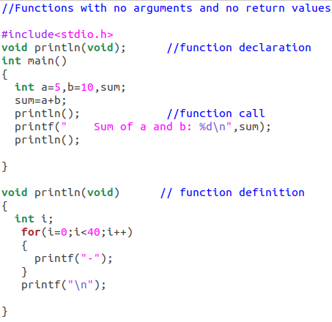
Functions with no arguments and no return values

Slide 11
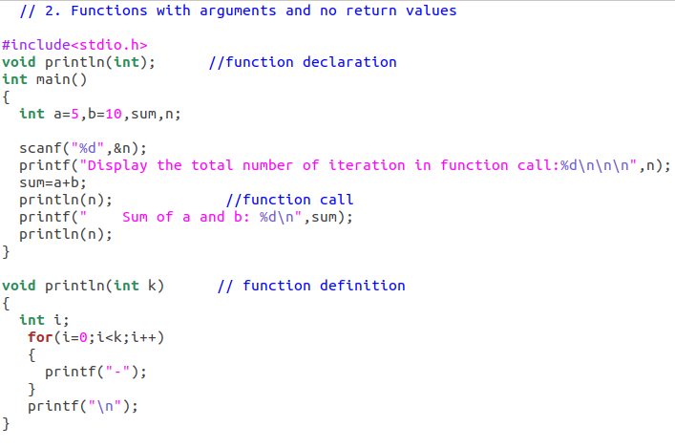
Functions with arguments and no return values

Slide 12
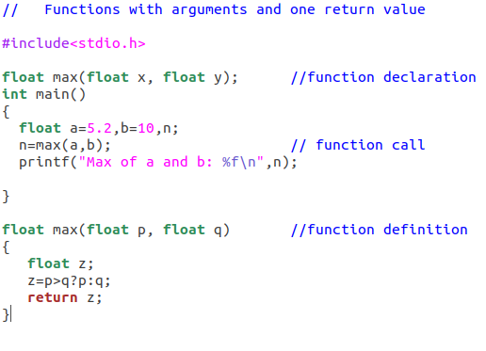
Functions with arguments and one return value

Slide 13
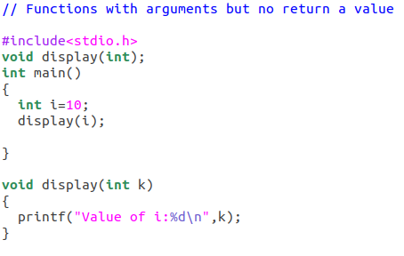
Functions with no arguments but return a value

Slide 14
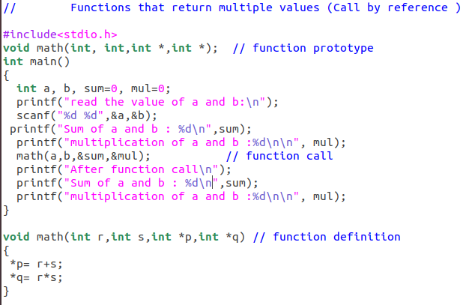
Functions that return multiple values

Slide 15
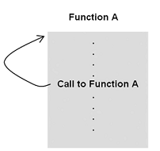
RECURSIVE FUNCTIONS
A function is said to be recursive if a statement within the body of the function calls itself.

Slide 16
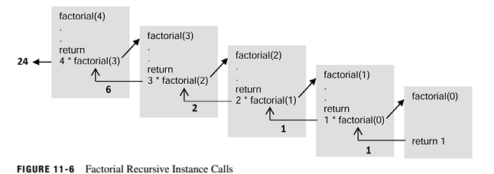

Slide 17
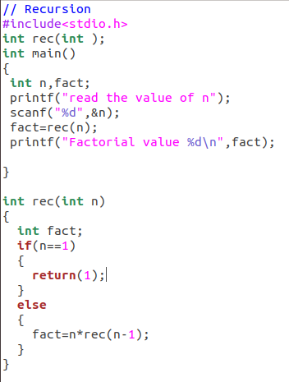

Slide 18
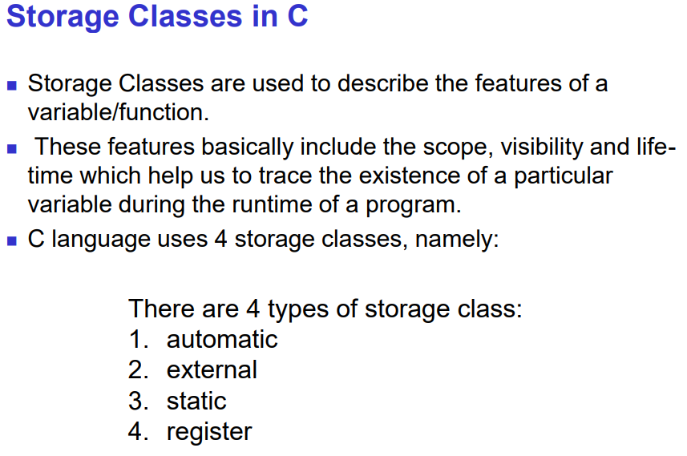

Slide 19
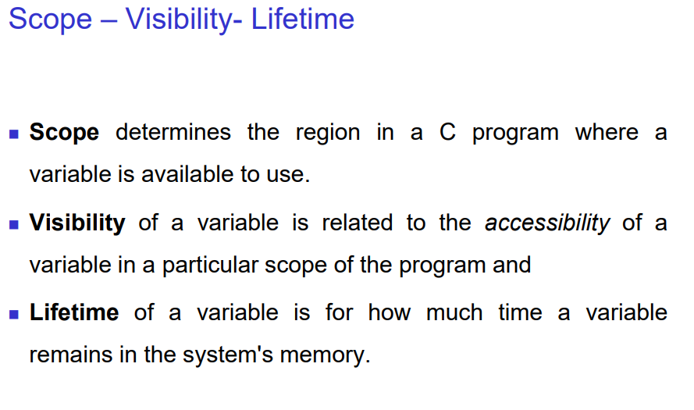

Slide 20
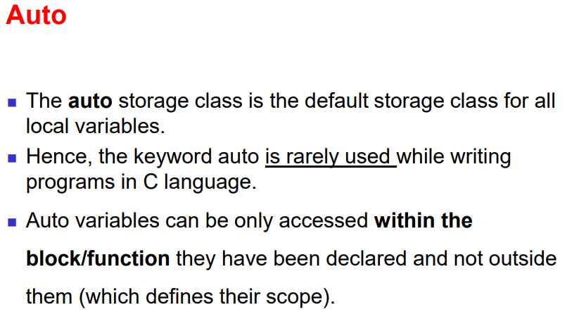

Slide 21
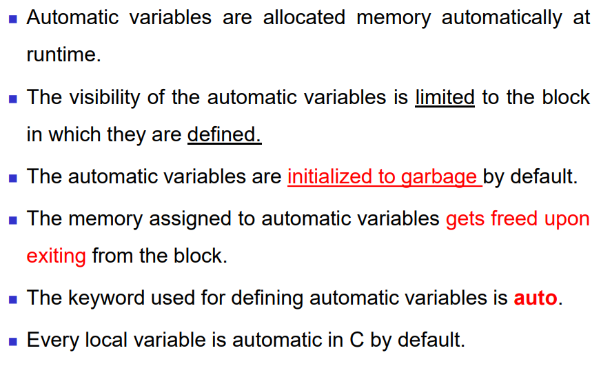

Slide 22
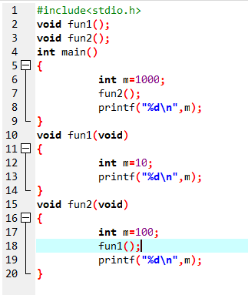

Slide 23
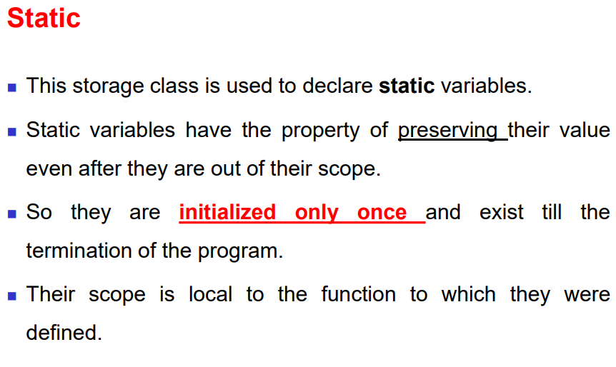

Slide 24
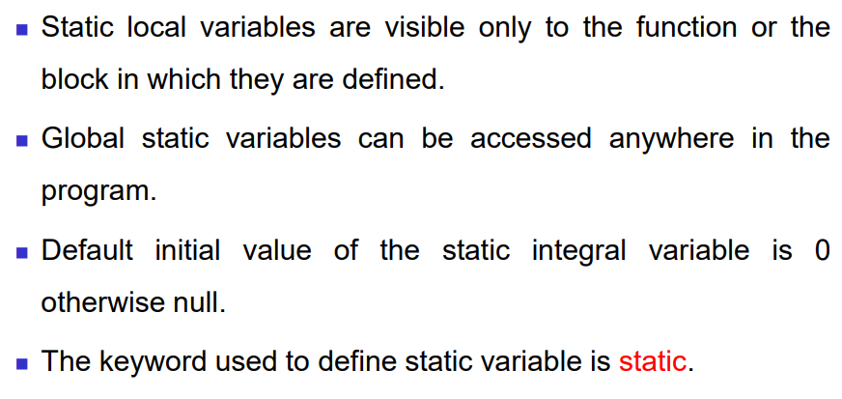

Slide 25
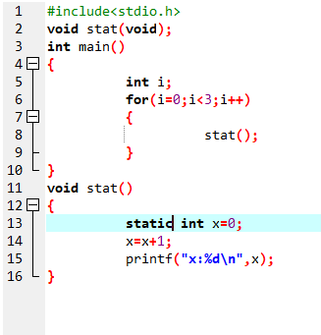

Slide 26
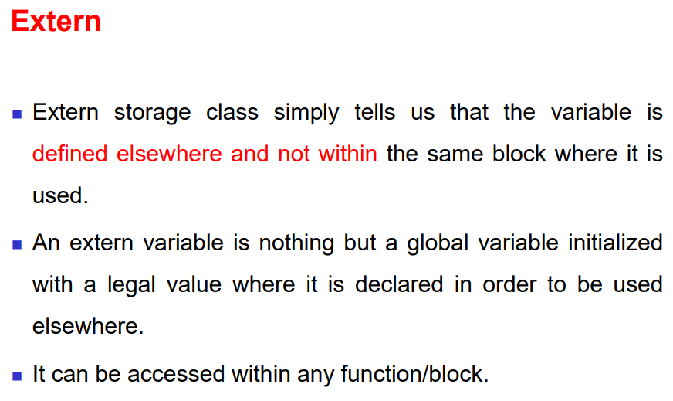

Slide 27
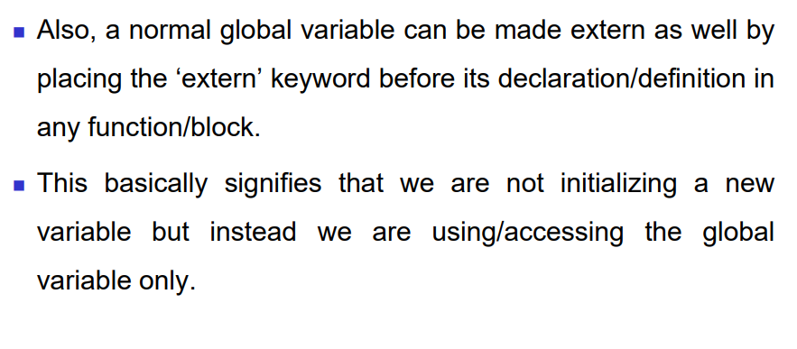

Slide 28
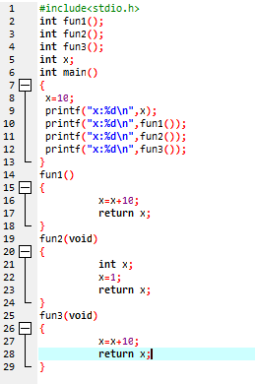
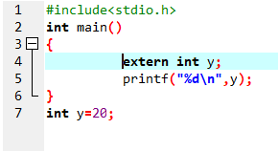

Slide 29
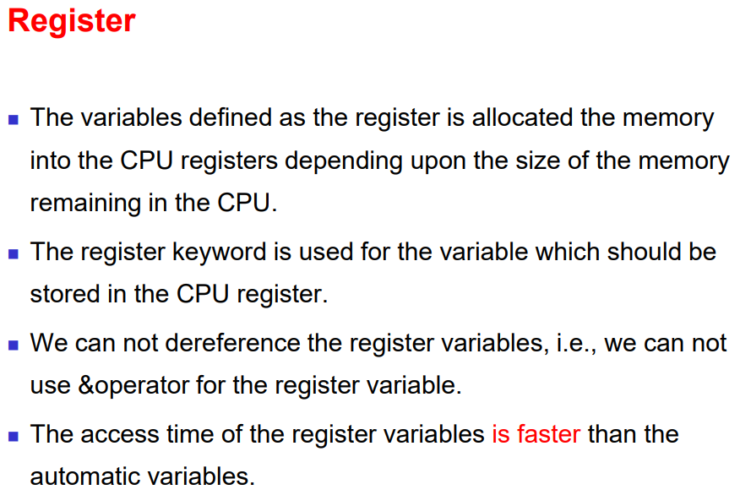

Slide 30
